Slide 1

Table Of Content
Why EDA in 2018?
Microservice Challenges
Reference Architecture
Kafka and Event Streams
Event Storming Methodology
Even-driven design patterns
Reference Implementation
Data replication for continuous availability
Real time analytics and AI

Slide 2

IBM Event Streams Apache Kafka for the Enterprise

Slide 3
Apache Kafka is an Open-Source Streaming Platform
PUBLISH & SUBSCRIBE
Read and write streams of data like a messaging system.
PROCESS
Write scalable stream processing applications that react to events in real-time.
STORE
Store streams of data safely in a distributed, replicated, fault-tolerant cluster.
https://kafka.apache.org/
IBM cloud architecture Kafka notes
Notes:
Kafka was originally developed at LinkedIn in 2010 and opened sourced in 2011
A version and extras maintained by Confluent, the original Kafka creators from LinkedIn
A distributed publish and subscribe middleware where all records are persistent
Used as a part in Event Driven Architectures
Fault tolerant and scalable when running multiple brokers with multiple partitions
Kafka runs on Java with clients in many languages
Uses Apache Zookeeper for metadata (leader and follower setup)
Can be used with Java Messaging Services (JMS), but does not support all features
Kafka clients are written in many languages
C/C++, Python, Go, Erlang, .NET, Clojure, Ruby, Node.js, Proxy (HTTP REST), Perl, stdin/stdout, PHP, Rust, Alternative Java, Storm, Scala DSL, Clojure, Swift

Slide 4
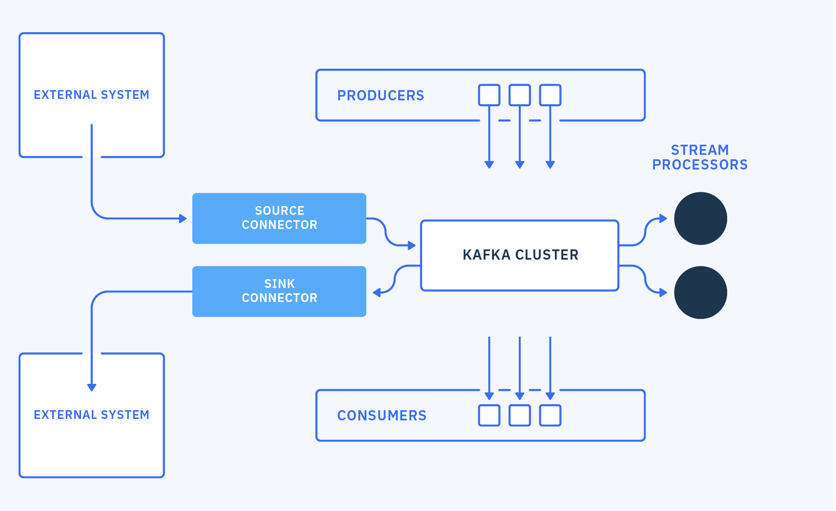
Solution Components
Notes:
This was an introduction to Apache Kafka, it is highly configurable and can be set up to your exact requirements so recommend you try it out for yourself.

Slide 6
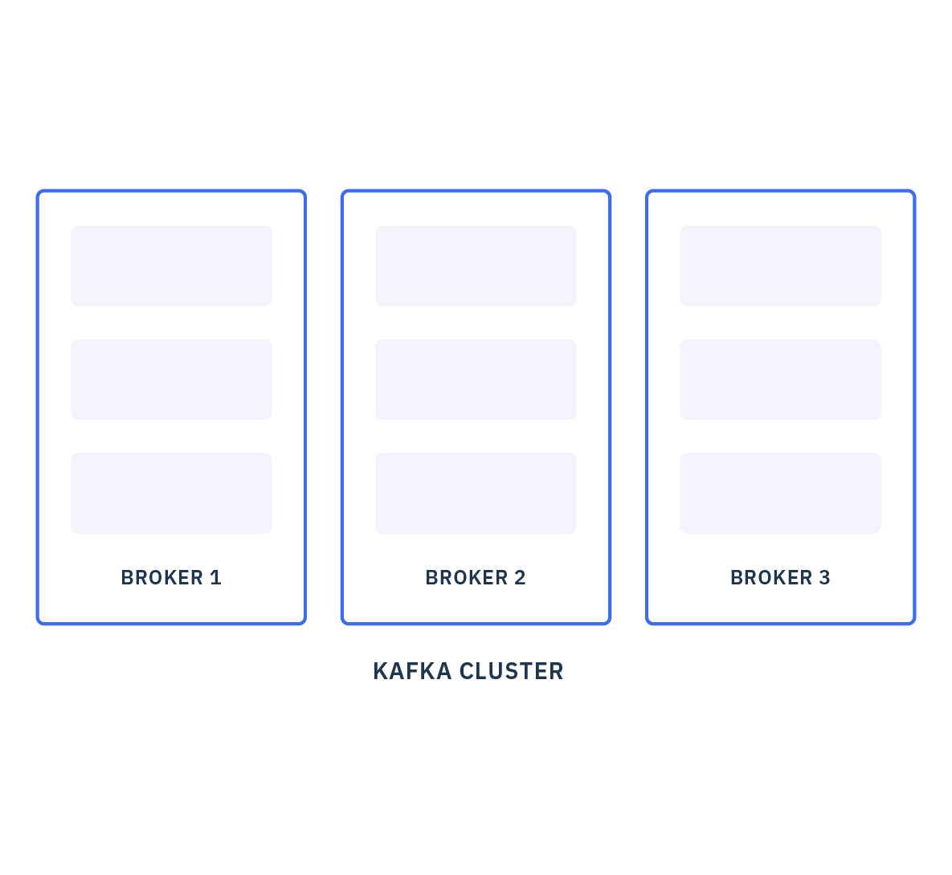
Brokers
Notes:
A Kafka cluster consists of a set of brokers.
A cluster has a minimum of 3 brokers.

Slide 7
Brokers and cluster
Cluster
A Kafka cluster consists of a set of brokers
A broker is an instance of Kafka uniquely identified in the cluster
All brokers in a cluster know about all other brokers
All information is written to disk
A connection to a broker is called the bootstrap broker
A cluster durably persists all published records for the retention period
Broker-0 Server
Broker-1 Server
Broker-2 Server
ZooKeeper Ensemble
Node 1
Node 2
Node 3

Slide 8
Kafka Architecture
Producers
Consumer
Cluster
Producers
Consumer
Broker-0 Server
Producers
Consumer
Broker-1 Server
External System
Broker-2 Server
External System
Source Connector
Sink Connector
ZooKeeper Ensemble
Node 1
Node 2
Node 3
Notes:
A Kafka cluster consists of a set of brokers.
messages on a topic are not immediately removed after they are consumed
Each partition of a topic consists of a sequence of files called log segments. The size of the log segments is determined by the cluster configuration log.segment.bytes (default is 1 GB). This can be overridden by using the topic-level configuration segment.bytes.
Disk Space: sufficient disk space in the persistent storage for the Kafka brokers to meet your expected throughput and retention requirements
Sum (Nb messages per minutes * average size * retention time * replica factor) per topic

Slide 9
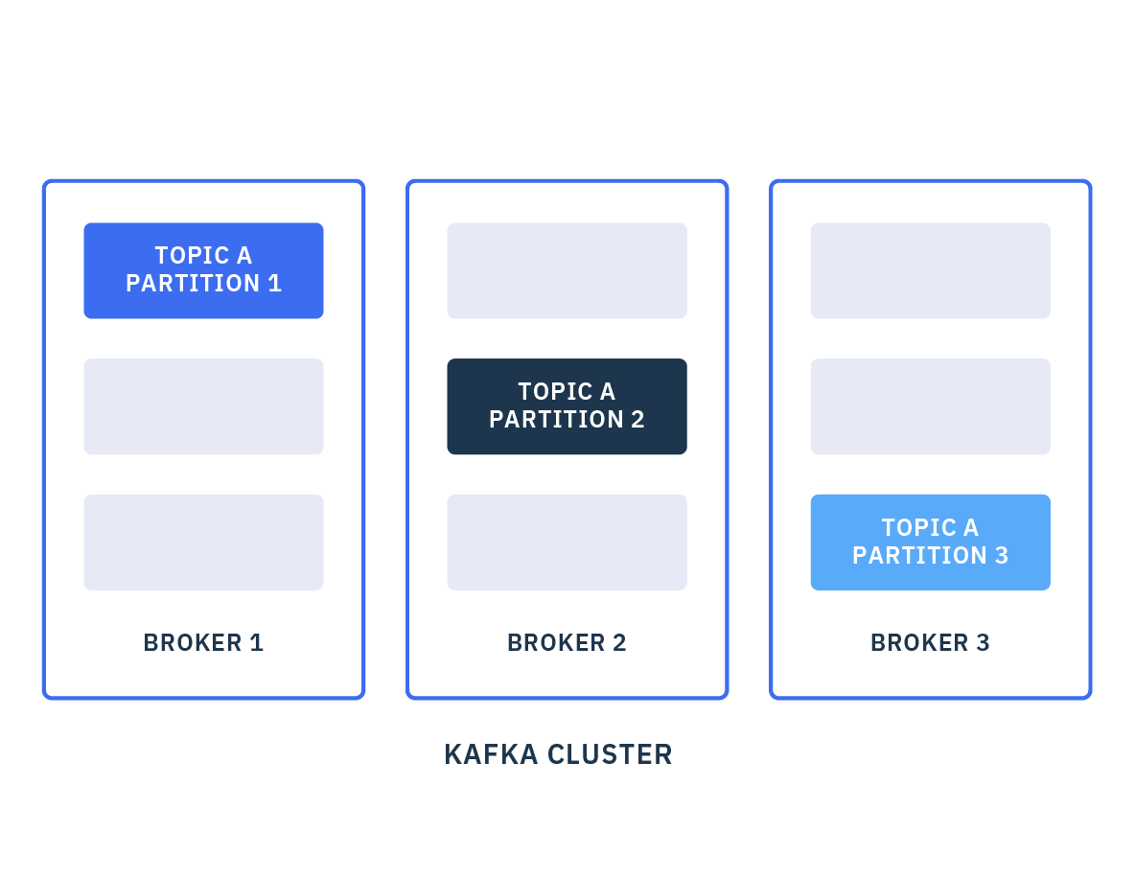
Partitions
Partition 1
Partition 2
TOPIC
Partition 3
https://ibm-cloud-architecture.github.io/refarch-eda/kafka/arch/
Notes:
Brokers hold topics (more on that later)
A topic is made up of one or more partitions.
By having multiple partitions distributed across the brokers, a topic can handle a large scale of traffic without overloading one broker.

Slide 10
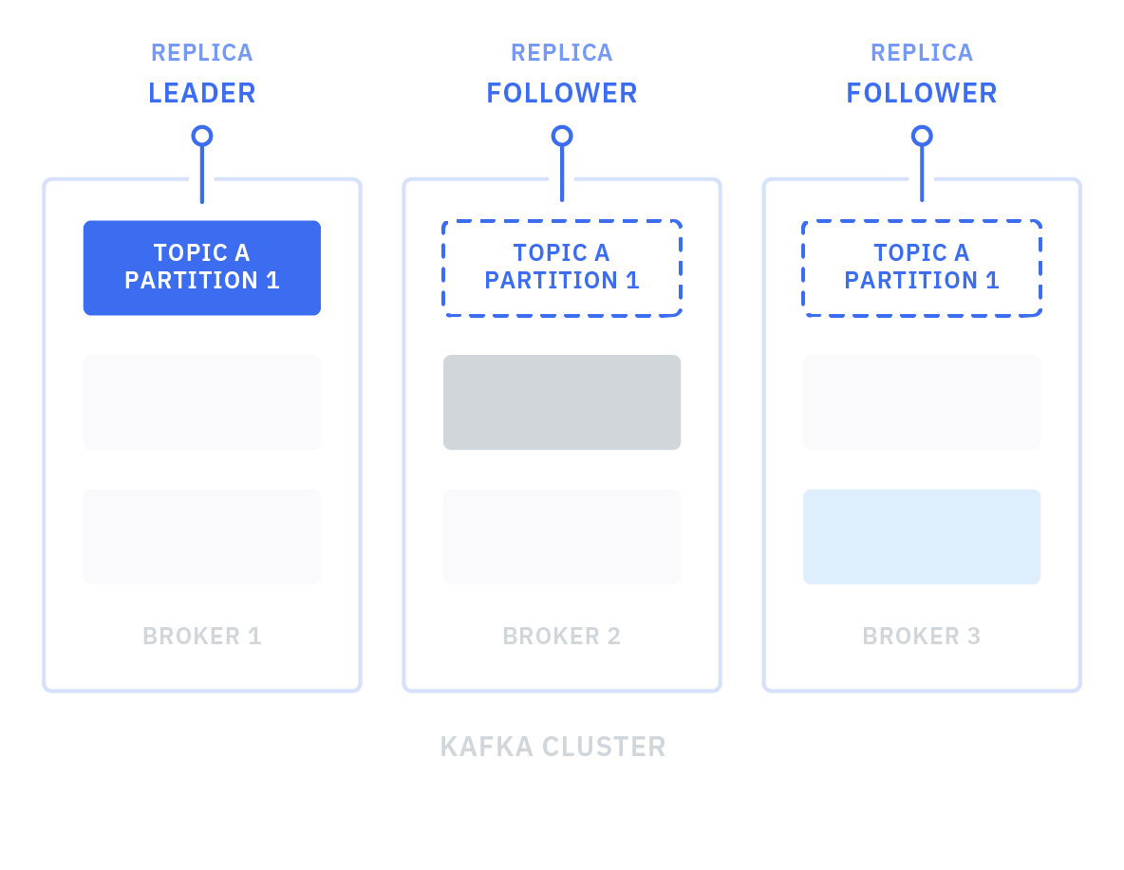
Replication
Notes:
In order to improve availability, each topic can be replicated onto multiple brokers. For each partition, one of the brokers is the leader, and the other brokers are the followers.
Replication works by the followers repeatedly fetching messages from the leader. This is done automatically by Kafka.
For production we recommend at least 3 replicas: you’ll see why in a minute.

Slide 11
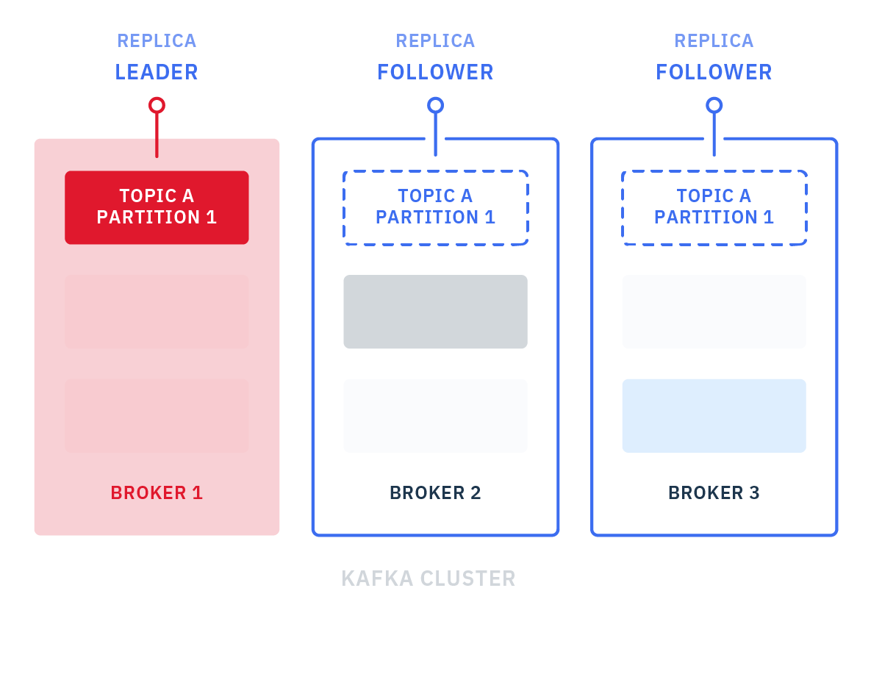
Replication
Notes:
Imagine a broker goes down, this means the leader of Topic A, partition 1 is offline

Slide 12
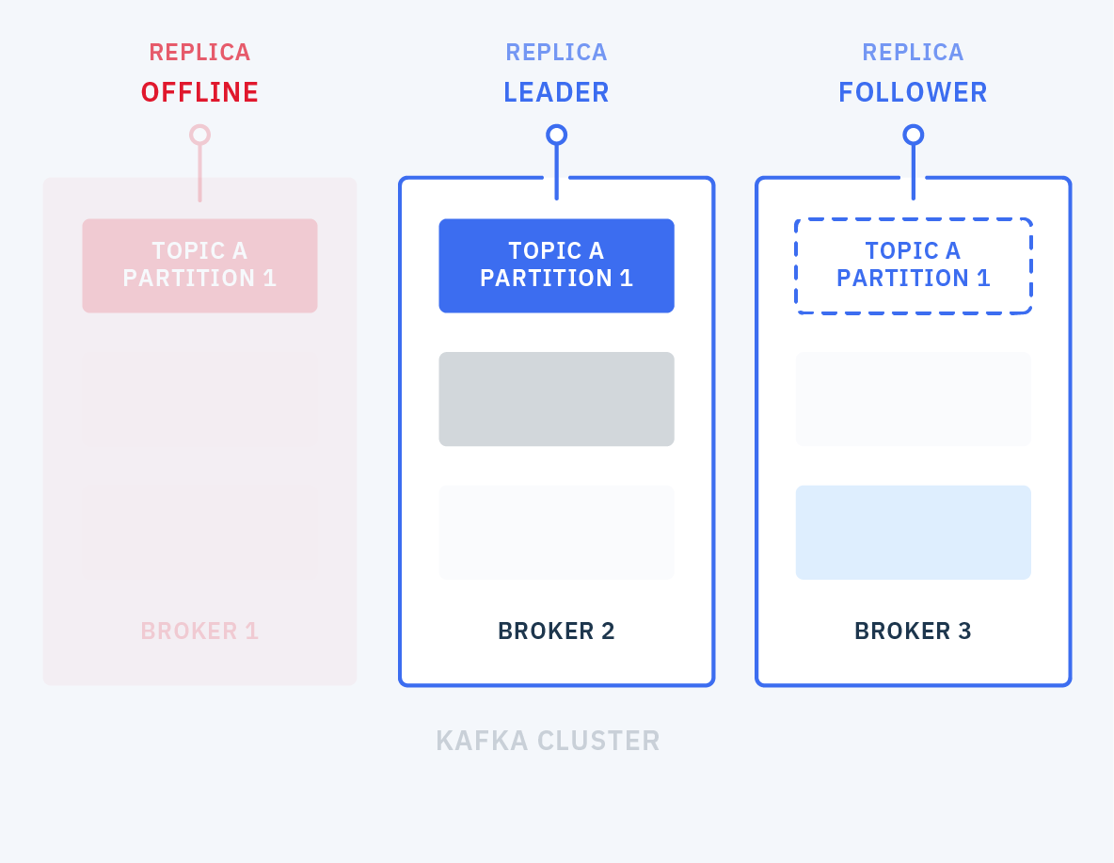
Replication
Notes:
This will trigger leader election – a new leader is selected from the other available brokers.
The means topic and partition remain available even though a broker is down – this is how Kafka provides availability.
During normal operation you may need to restart brokers to apply config changes etc, this is why you want at least 3 brokers. If you are restarting broker 1 and broker 2 goes down, there is still a broker left standing.

Slide 14
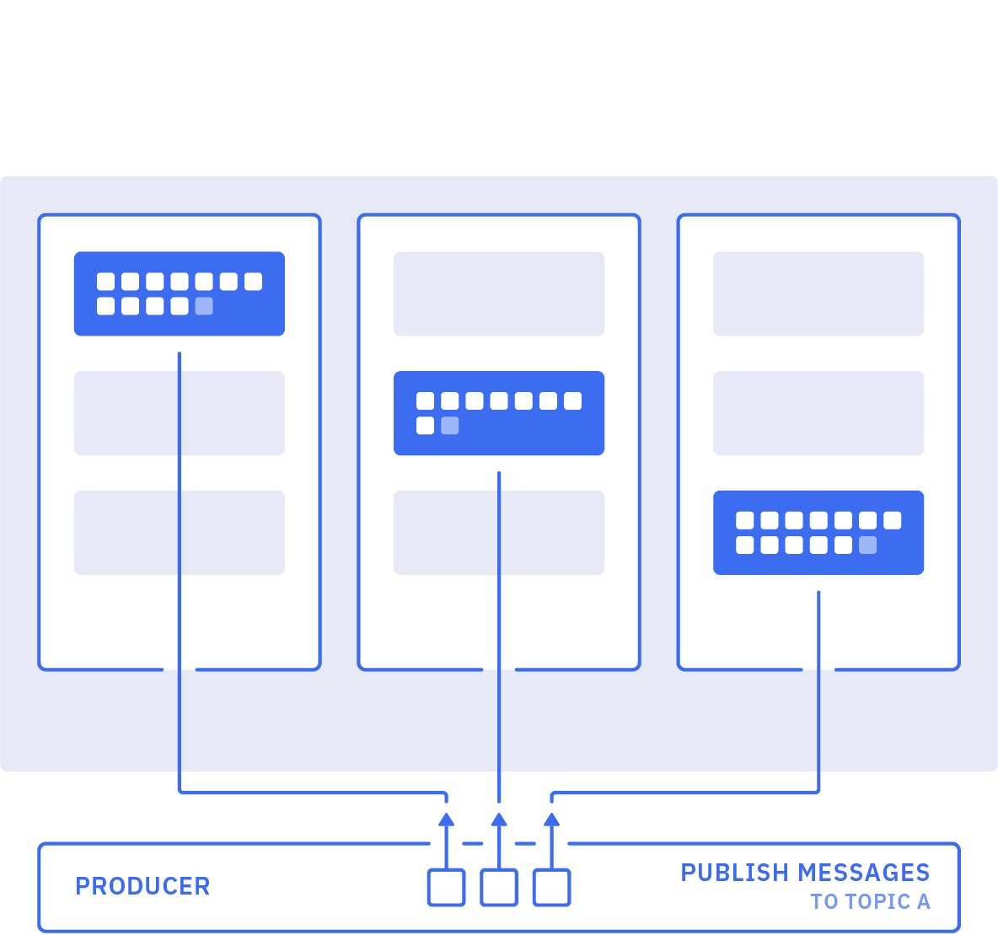
Producers
Notes:
Producers
A producer publishes messages to one or more topics.

Slide 15
Topics
0
1
2
3
4
5
Offset
Notes:
Topic is an umutable sequence of records.
Always append to the end and the numbers indicate offsets -> offset number will always increase

Slide 16
Topics and Keys
Topic
Partition 0
0
1
2
3
Partition 1
0
1
2
3
Partition 2
0
1
2
3
https://ibm-cloud-architecture.github.io/refarch-eda/kafka/readme/ - partitions
Notes:
An individual record is made up of a key and a value.
Partitions are basically used to parallelize the event processing when a single server would not be able to process all events,
Each partition will run on a separate server. If you have 5 brokers you can define topic with 5 partitions.
Each partition is replicated across a configurable number of servers for fault tolerance.

Slide 17
Retention Period and Compaction
log.retention.minutes = 3000
log.retention.bytes = 1048
Retention set in time or size
Compacted topics are evolving data stores
0
key:a
val:A1
1
key:b
val:B1
2
key:a
val:A2
3
key:c
val:C1
4
key:c
val:C2
5
key:b
val:B2
Partition 0
2
key:a
val:A2
4
key:c
val:C2
5
key:b
val:B2
Partition 0
(rewritten)
Notes:
Records on topics are not kept forever. Kafka will remove old records.
This can be either set to remove after a certain amount of time, or when the log reaches a certain size.
Compaction is an alternative way to remove records
When compaction is turned on Kafka will periodically remove all old records for a given key.
So in the example here only the offsets 2,4 and 5 are kept since they represent the last record with that key

Slide 18
Producers and Keys
Topic
Partition 0
0
1
2
3
4
Partition 1
0
1
2
3
4
Partition 2
0
1
2
3
4
When no key is set, producers records will be appended in a round-robin fashion
Notes:
When no key is set, producers records will be appended in a round-robin fashion

Slide 19
Producers and Keys
Topic
Partition 0
0
1
2
3
4
5
6
7
Partition 1
0
1
2
3
4
5
Partition 2
0
1
2
3
4
5
If a key is set, Kafka will always append records with that same key to the same partition
Notes:
If a key is set, Kafka will always append records with that same key to the same partition
Kafka guarantees ordering on a topic in a particular partition
Worth noting this is only true while the number of partitions remains static, if you add more partitions, Kafka might start putting records with the same key to a different partition -> so ordering is no longer guaranteed

Slide 20
Kafka Producers
A Producer writes a record to a Topic
If there are more than 1 partition then round robin is used to each partition of the topic
If a key is given, then the record will always be written to a single partition
Producers can be idempotent, which prevents sending a message twice
Producers can use message compression
Compression codecs supported are Snappy, GZIP and LZ4
Consumers will automatically know a message is compressed and decompress
Notes:
Serializers: ByteArraySerializer, ByteBufferSerializer, BytesSerializer, DoubleSerializer, ExtendedSerializer.Wrapper, FloatSerializer, IntegerSerializer, LongSerializer, SessionWindowedSerializer, ShortSerializer, StringSerializer, TimeWindowedSerializer, UUIDSerializer
Deserializers: ByteArrayDeserializer, ByteBufferDeserializer, BytesDeserializer, DoubleDeserializer, ExtendedDeserializer.Wrapper, FloatDeserializer, IntegerDeserializer, LongDeserializer, SessionWindowedDeserializer, ShortDeserializer, StringDeserializer, TimeWindowedDeserializer, UUIDDeserializer
When an idempotent producer is set the property producerProps.put("enable.idempitence", "true") is added. This changes the following settings: retries = MAX_INT, acks=all,

Slide 21
Producers
Producer can choose acknowledgement level:
0
Fire-and-forget
Fast, but risky
Topic
1
Waits for 1 broker to acknowledge
Partition 0
0
1
2
3
4
5
6
7
ALL
Waits for all replica brokers to acknowledge
Producer can choose whether to retry:
Partition 1
0
1
2
3
4
5
0
Do not retry
Loses messages on error
>0
Retry
Retry, might result in duplicates on error
Partition 2
0
1
2
3
4
5
Producer can also choose idempotence
Can retry without risking duplicates
Notes:
Kafka producers have a lot of configuration options – will only discuss a couple of key ones
Attention exactly once is a combination of things. Message delivery could not be 100% reliable. Network and machine could fail. A high level of coordination to guaranty exactly once delivery has a cost in latency and processing. The underlying protocol is still using at-least once delivery.
When producer does not receive a message, you need to ask if message is dropped, or if the ack is dropped, or is it the receiver who crash, or network is slow… The most important is to ensure idempotence.
It is possible to get message duplication if a producer did not receive acks but the message was really processed by the consumer. So consumer has to perform deduplication or handle incoming messages in an idempotent way.
With stateless messaging once the ack is sent, if the receiver crashes before or during its processing, the data is lost forever.

Slide 22
Kafka Producers
Producers can send messages in batches for efficiency
By default 5 messages can be in flight at a time
More messages are placed in batch and sent all at once
Creating a small delay in processing can lead to better performance
Batch waits until the delay is expired or batch size is filled
Messages larger than the batch size will not be batched
If Producers are sending faster than Brokers can handle then the Producers can be slowed
Set the buffer memory for storage
Set the blocking time (milliseconds)
Throw an error message that the records cannot be sent
Schema Registry is available to validate data using Schema Registry
Uses Apache Avro
Protects from bad data or mismatches
Self describing
Notes:
To add a delay change the property:
batch linger.ms = 5 (default 0)
To change the batch size :
batch.size (default 16 kb)
To change the buffer memory :
buffer.memory (default 32 MB)
To change the blocking milliseconds:
max.block.ms (default 1)

Slide 23
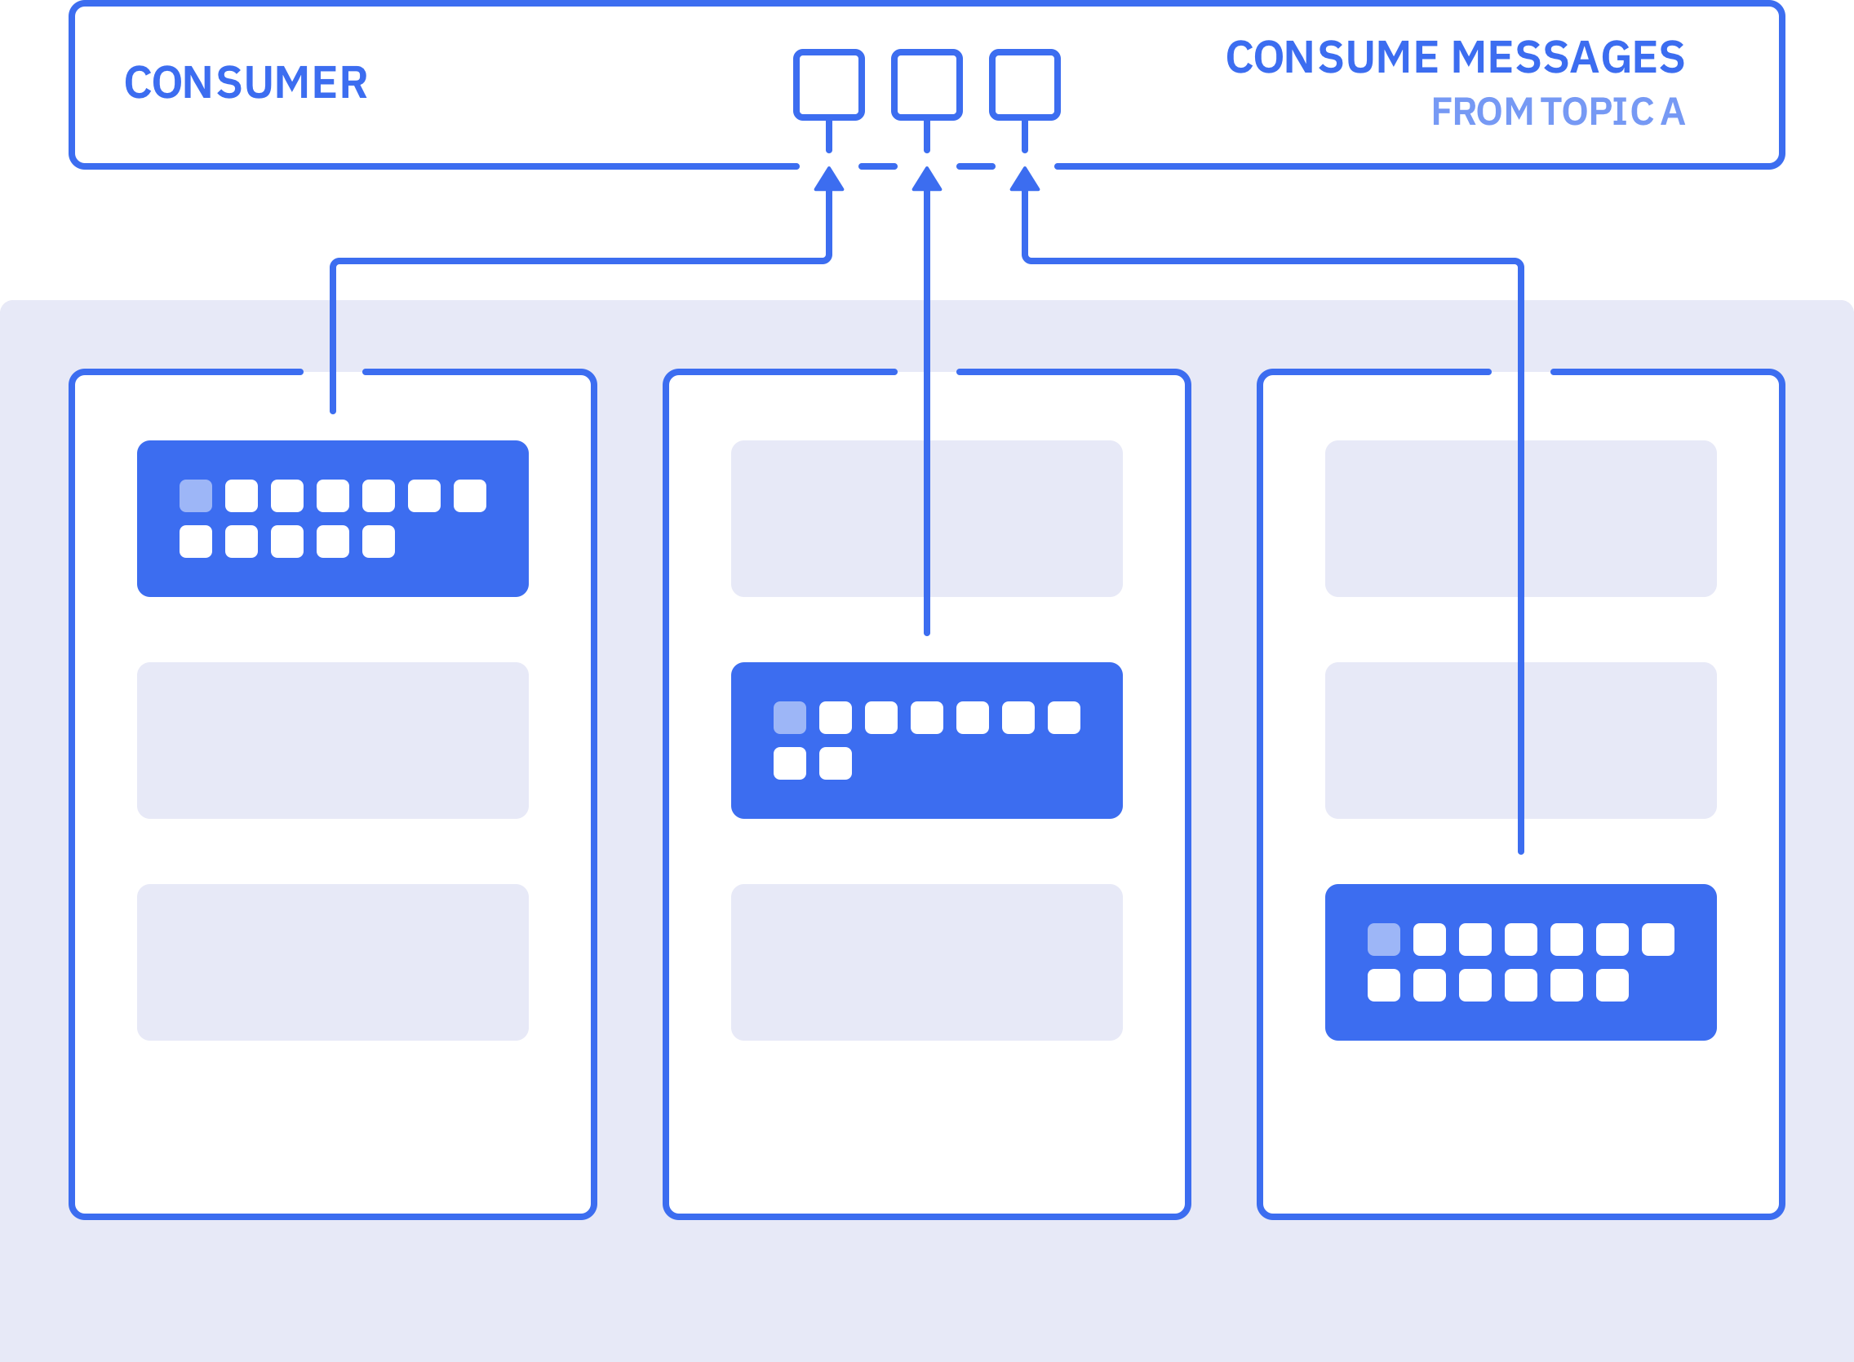
Consumers
Notes:
Consumers
A consumer reads messages from one or more topics and processes them

Slide 24
Kafka Consumers
Consumers subscribe to 1 or more Topics
Read from all partitions from the last offset and consumes records in FIFO order
Can have multiple consumers subscribed to a topic
Consumers can set the offset if records need to be processed again
Consumers can be idempotent by coding
Schema Registry is available

Slide 25
Consumers
Consumer can choose how to commit offsets:
Automatic
Commits might go faster than processing
Manual, asynchronous
Fairly safe, but could re-process messages
Manual, synchronous
Safe, but slows down processing
0
1
2
3
4
5
6
A common pattern is to commit offsets on a timer
Exactly once semantics
Consumer A
Offset 2
Consumer B
Offset 5
Can group sending messages and committing offsets into transactions
Primarily aimed at stream processing applications
Notes:
Consumers can start reading from any offset on a topic, they store the offset they got to in a special hidden topic in Kafka incase the consumer goes down and has to find out where it got to.
Again lots of options for configuration, here are a couple that are worth being aware of.

Slide 26
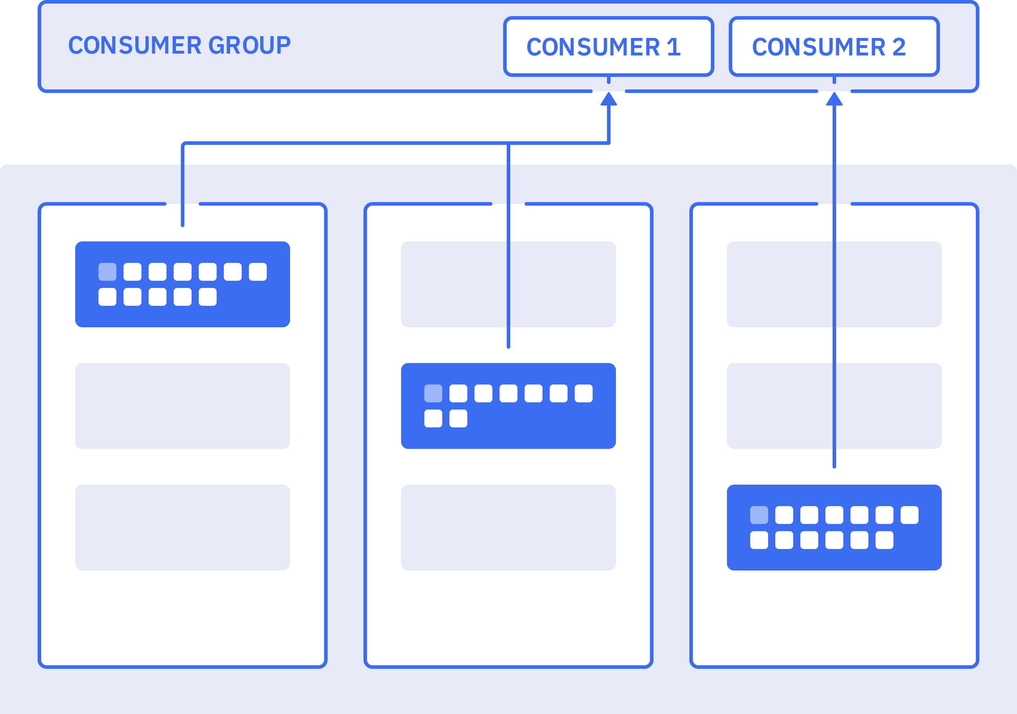
Consumer Groups
Notes:
To allow scalability of consumers, consumers are grouped into consumer groups. Consumer declare what group they are in using a group id
Multiple Consumers in a consumer groups will read each from a fixed amount of partitions exclusively
Having more consumers in a group than partitions will lead to inactive consumers
Adding or removing Consumers will automatically rebalance the Consumers with the number of partitions

Slide 27
Consumer Groups
Consumer Group A
Topic
Consumer
p0, offset 7
Consumer
p1, offset 3
Partition 0
0
1
2
3
4
5
6
7
Consumer
p2, offset 5
Partition 1
0
1
2
3
Consumer Group B
Consumer
p0, offset 7
Partition 2
0
1
2
3
4
5
Consumer
p1, offset 3
p2, offset 5
Notes:
Suppose we have two consumer groups, each wanting to consume from the topic. Kafka will make sure that between all the consumers they will see every message on a topic.

Slide 28
Consumer Groups
Consumer Group A
Topic
Consumer
p0, offset 7
Consumer
p1, offset 3
Partition 0
0
1
2
3
4
5
6
7
Consumer
p2, offset 5
Partition 1
0
1
2
3
Consumer Group B
Consumer
p0, offset 7
Partition 2
0
1
2
3
4
5
Consumer
p1, offset 3
p2, offset 5
Notes:
So for consumer group A this means each consumer gets one partition

Slide 29
Consumer Groups
Consumer Group A
Topic
Consumer
p0, offset 7
Consumer
p1, offset 3
Partition 0
0
1
2
3
4
5
6
7
Consumer
p2, offset 5
Partition 1
0
1
2
3
Consumer Group B
Consumer
p0, offset 7
Partition 2
0
1
2
3
4
5
Consumer
p1, offset 3
p2, offset 5
Notes:
For consumer group B one consumer get one partition..

Slide 30
Consumer Groups
Consumer Group A
Topic
Consumer
p0, offset 7
Consumer
p1, offset 3
Partition 0
0
1
2
3
4
5
6
7
Consumer
p2, offset 5
Partition 1
0
1
2
3
Consumer Group B
Consumer
p0, offset 7
Partition 2
0
1
2
3
4
5
Consumer
p1, offset 3
p2, offset 5
Notes:
…and the other get two partitions

Slide 31
Consumer Groups
Consumer Group A
Topic
Consumer
p0, offset 7
Consumer
p1, offset 3
Partition 0
0
1
2
3
4
5
6
7
Consumer
p2, offset 5
Consumer
Partition 1
0
1
2
3
Consumer Group B
Consumer
p0, offset 7
Partition 2
0
1
2
3
4
5
Consumer
p1, offset 3
p2, offset 5
Notes:
If you added an extra consumer to consumer group A it would sit idle, since there aren’t any spare partitions – this isn’t ideal but could be useful if you want it to quickly pick up the slack if one of the other consumers went down

Slide 32
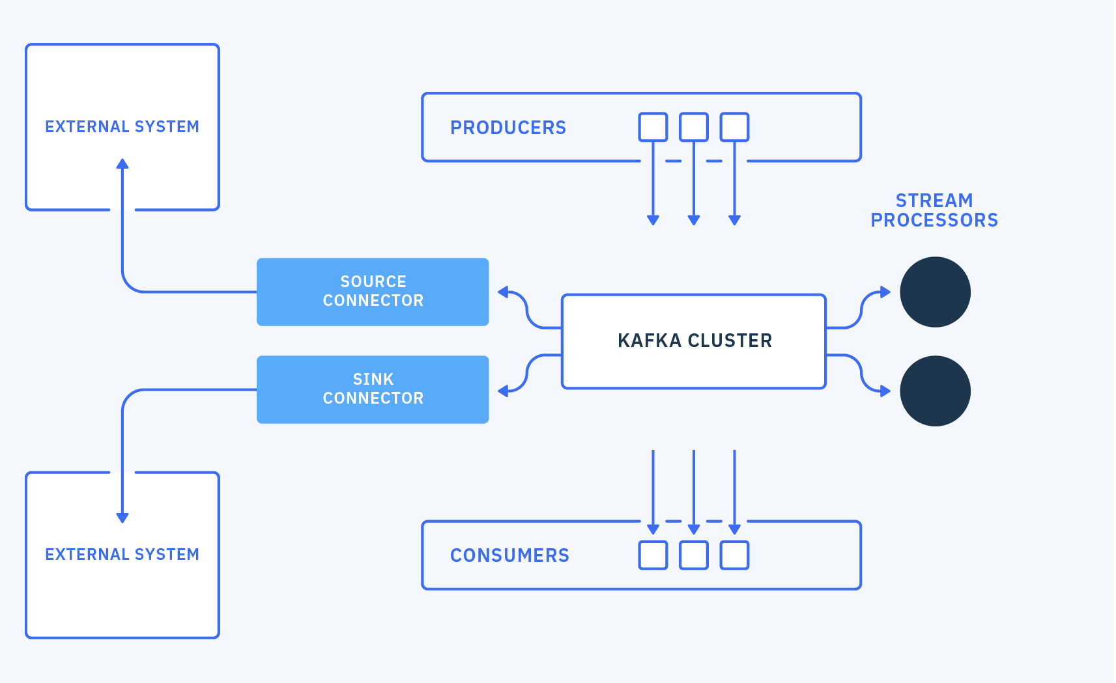

Slide 33
Kafka Streams
Client library for processing and analyzing data stored in Kafka
Processing happens in the app
Supports per-record processing – no batching
my-input
FILTER
MAP
my-output
Notes:
Streams: unbounded flow of facts - key, value pairs, they can have types
Kafka Streams is an open source Java api
No separate processing cluster required – processing happens in your app
Supports per-record stream processing – no batching
Stateless processing, stateful processing, windowing
Elastic, highly scaleable, fault-tolerant
Fully integrated with Kafka security
Supports exactly once semantics

Slide 34
Kafka Streams
Input topic
foo
red
bar
orange
foo
yellow
bingo
green
bingo
blue
bar
purple
KStream<String, String> source = builder.stream("my-input")
.filter((key,value) -> key.equals("bingo"))
.map((key,value) -> KeyValue.pair(key, value.toUpperCase()))
.to("my-output");
Output topic
bingo
GREEN
bingo
BLUE
Notes:
Example:
Kafka streams app can take input of one or more topics, and can output 0 or more topics.
e.g. take these records with foo, bar etc being keys and red, orange etc the values
We filter to find all records with a key of bingo
Then apply a map to uppercase the values
Then push the records onto the output topic
Can you guess what the records on the output topic will be?

Slide 35
Streams
Consumers from a Topic, processes data, and Publishes in another Topic
Several built in functions to process or transform data
Can create other functions
branch, filter, filterNot, flatMap, flatMapValues, foreach, groupByKey, groupBy, join, leftJoin, map, mapValues, merge, outerJoin, peek, print, selectKey, through, transform, tranformFormValues
Exactly once processing
Event time windowing is supported
Group of records with the same key perform stateful operations

Slide 36
Kafka Streams examples
Getting started with KStreams
https://kafka.apache.org/documentation/streams/
The refer container microservice has one implementation in kstreams:
https://ibm-cloud-architecture.github.io/refarch-kc-container-ms/kstreams/
ContainerOrderAssignment.java

Slide 38



Kafka Connect – bridge to cloud-native apps
Event Backbone
Notes:
Kafka Connect allows you to use Kafka to extract events from existing systems to power next generation of responsive, cloud-native applications
You can do this with minimal changes to your existing system

Slide 39
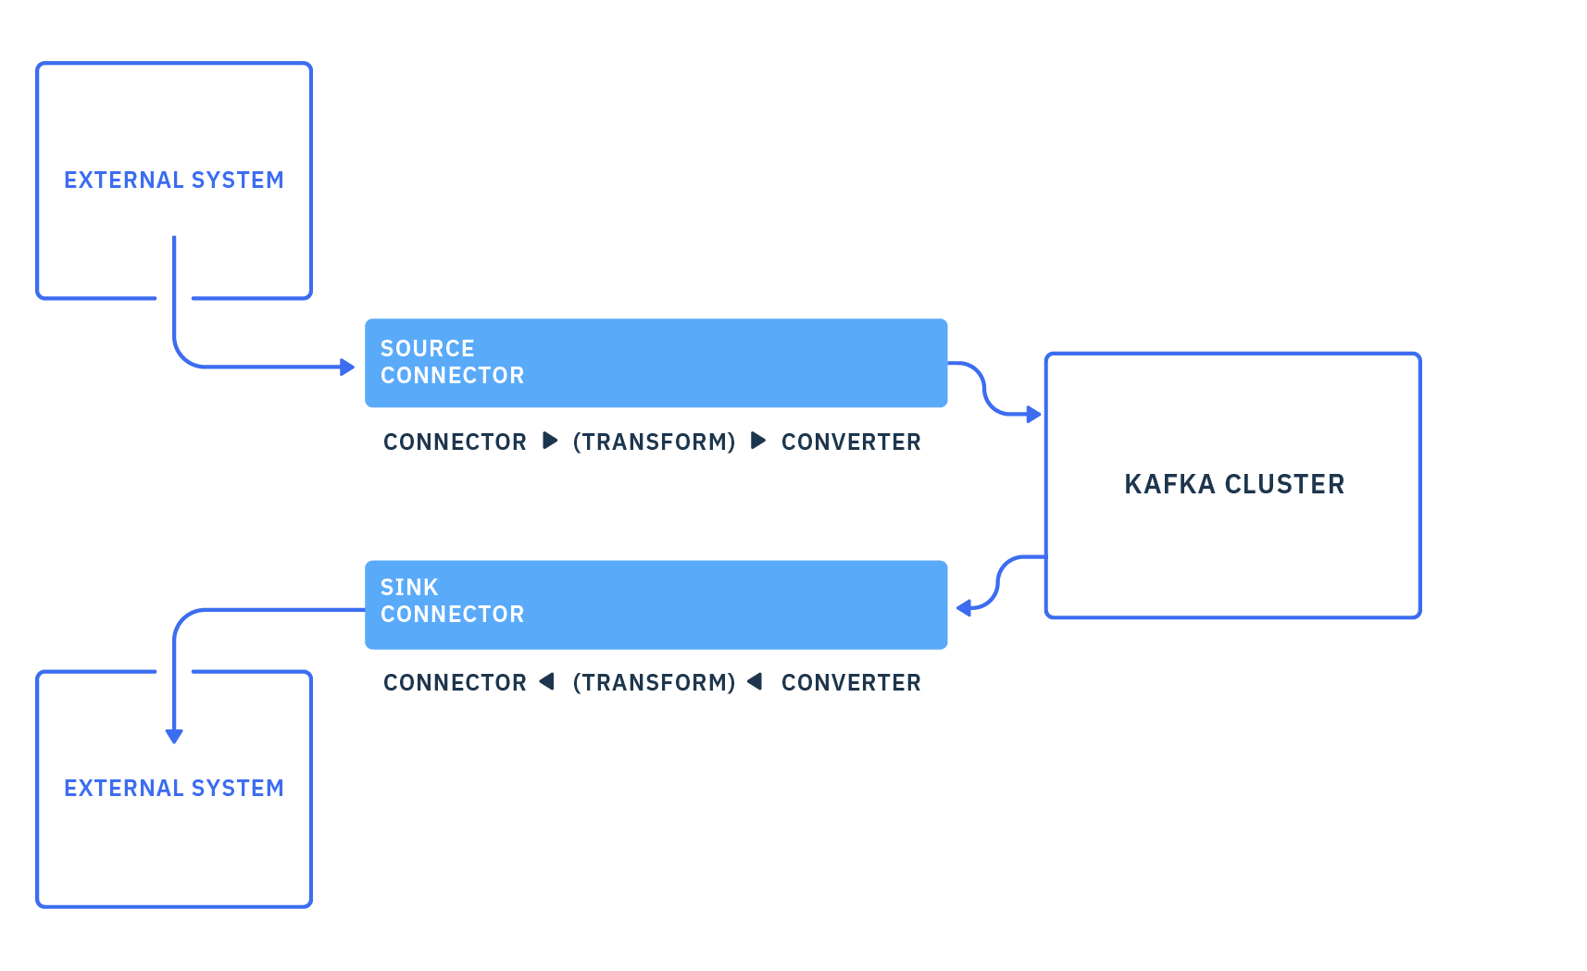
Kafka Connect
Over 80 connectors
HDFS
Elasticsearch
MySQL
JDBC
IBM MQ
MQTT
CoAP
+ many others
Notes:
Kafka connect is another open source Java api
Useful for connecting Kafka to systems where you can’t run a Kafka client
Many connectors available, often open source

Slide 40
Notes:
This was an introduction to Apache Kafka, it is highly configurable and can be set up to your exact requirements so recommend you try it out for yourself.

Slide 41
IBM Event Streams

Slide 42
IBM Event Streams Delivers Differentiated Value
IBM offers Event Streams in several form factors:
IBM has years of operational expertise running Apache Kafka for Enterprises
This experience has been embedded in the DNA of Event Streams
Event Streams makes Kafka easy to run, manage & consume, reducing skill requirements and increasing speed of deployment for faster time to value
IBM Cloud Private security integration simplifies Kafka access control using roles and policies
IBM’s experience in enterprise-critical software has shaped features like geo-replication for Disaster Recovery & integration with IBM MQ, to give confidence deploying mission-critical workloads
Support you can trust – IBM has decades of experience supporting the World’s toughest environments
Private Cloud
Container–native Software
Red Hat OpenShift
IBM Cloud Private
X86_64
X86_64 & zLinux
IBM Public Cloud
Isolated
aaS
Multi-tenant
aaS
https://www.ibm.com/cloud/event-streams

Slide 43
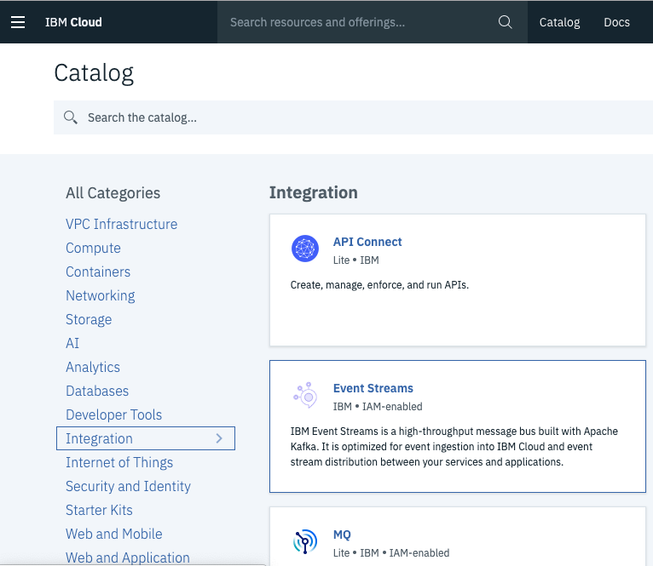
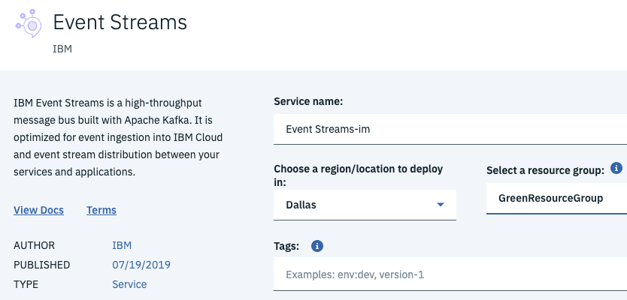
IBM Event Streams for IBM Cloud
Running Apache Kafka as a Service since 2015…
Notes:
The first major public cloud vendor to do so.

Slide 44
IBM Event Streams for IBM Cloud
Event Streams (aka Message Hub) has been running in the cloud since 2015
Multiple large multi-tenant clusters supporting thousands of users
6 worldwide hubs.
Many single tenant clusters across all industries, across all geographies
Clusters receive code updates continuously
All non disruptive and backwardly compatible
No planned maintenance windows
MULTIPLE components have failed in production over the years without major impact to service
Servers, storage, code, network
Clusters have been resilient to these failures
Notes:
Most of the code for ibm cloud is about infrastructure.
ES private cloud is moving features to public cloud.
Kafka 2.1 will be the next release. The cloud service is continuously delivering new feature.
Because we have a lot of issues, we are improving the availability, and design for resilience.

Slide 45

Cluster topology
Kafka Apps
REST Apps
Kafka Apps
Admin Apps
Customer Cluster
Kubernetes Cluster
Edge Plane (DMZ)
Network Zone
Edge Proxy
HTTP Ingress
Edge Proxy
HTTP Ingress
Edge Proxy
HTTP Ingress
Management Plane
Access Ctlr
Monitoring
Logs
Access Ctlr
Monitoring
Logs
Access Ctlr
Monitoring
Logs
…
…
…
…
…
…
…
…
…
Data Plane
Kafka
ZK
Kafka
ZK
Kafka
ZK
Block Storage
Block Storage
Block Storage
Availability Zone 1
Availability Zone 2
Availability Zone 3
Notes:
Separate by 3 AZ.
We can loose AZ (DC center outage).
Frankfurt – 3 AZ.
Multitenant is in Dallas.

Slide 46
Comparison with IBM Event Streams
 | IBM Event Streams | IBM Event Streams for IBM Cloud
Administration and operation | Customer | IBM operations team
Service and support | IBM service team | IBM operations team
Release model | Product releases, 3-6 months apart | Continuous delivery
Kafka version | 2.2 | 2.2, aim to follow Kafka closely
Availability zones | No | 3 AZs for Standard/Enterprise plan
Award-winning UI | Yes | Standard/Enterprise plan
REST Producer API | Yes | Standard plan
Schema Registry | Statement of direction
Kafka Connect API | Supported, MQ connectors included | Supported
Data replication / DR cross data center | Georeplication

Slide 47
Available plans
 | Classic | Standard | Enterprise
Cluster tenancy | Multi-tenant | Multi-tenant | Single-tenant
Availability zones | 1 AZ | 3 AZs | 3 AZs
Access control | Per-tenant access control | Access control policies | Access control policies
Kafka version | 1.1 | 2.2 | 1.1 (2.2 coming soon)
New Event Streams UI | No | Yes | Yes
REST producer API | No | Yes | No
Throughput limits | 1MB/s per partition | 1MB/s per partition | 40MB/s (90MB/s peak)
Retention | 1GB, 30 days | 1GB, 30 days | Limited by storage only
Availability | 99.5% | 99.95% | 99.95%
Pricing | Per partition month Message volume | Per instance hour Outbound data volume | Per instance hour
Notes:
The one we select depending of your use cases. ETP you pay for the storage you need.

Slide 48






Core Services of IBM Cloud Private
Enterprise Content Catalog
Open Source and IBM Middleware, Data, Analytics, and AI Software
Core Operational Services
Log Management, Monitoring, Metering, Security, Alerting
Self-service catalog
Agility, scalability, and elasticity
Self-healing
Enterprise security
No vendor lock-in
Kubernetes Container
Orchestration Platform
Choose your infrastructure:
IBM Z
48
48
Notes:
Always deploy kafka on k8s. Simplify the deployment, and the storage management.
WebUI is added. Stateless and can be well managed inside k8s
Leverage core operational services. Like OS capa but for cloud.
ETP catalog where event stream

Slide 49
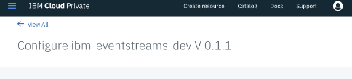
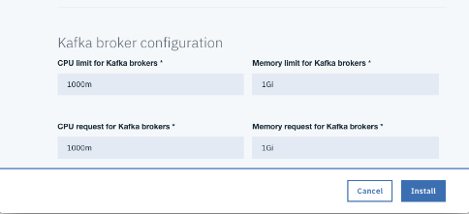
IBM Event Streams On-Premise
Easy to deploy
Kafka has many distinct components to deploy, configure and coordinate for secure connectivity
Container placement critical to ensure production-level availability
Secured network traffic ingress
Ensuring consistent and repeatable deployment
Notes:
From the catalog you can access to the software packaged. You configure, and minute later you have a kafka cluster

Slide 50
Orchestrated with Kubernetes and Helm
IBM Event Streams is packaged as a Helm chart
A 3-node Kafka cluster, plus ZooKeeper, UI, network proxies and so on is over 20 containers
Kubernetes and Helm brings this all under control
Just choose IBM Event Streams from the catalog to deploy a Kafka cluster with ease
It comes
Highly available
Secure
Ready for production
Notes:
By default you have 3 nodes, but you can add more
Helm release

Slide 51
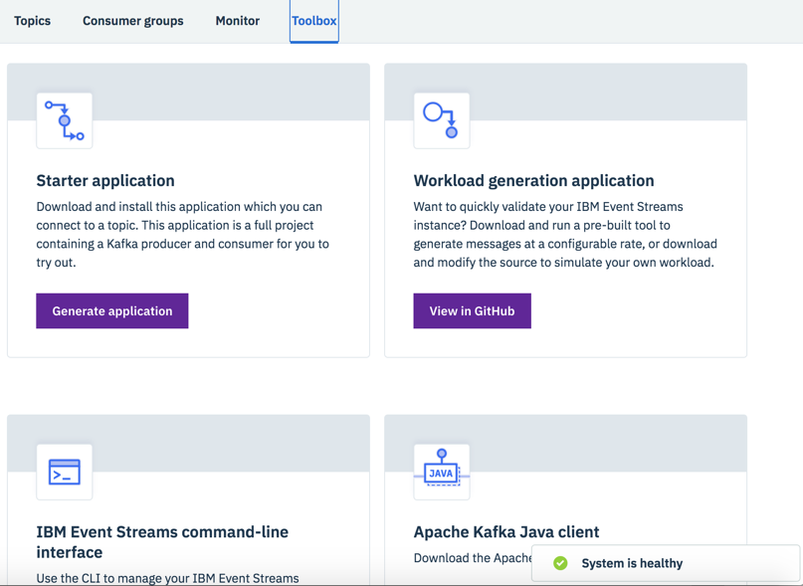
IBM Event Streams On Premise
Visualisation of your topic data
Tools to boost productivity
Notes:
We added a UI, a CLI, to be more effective to manage configuration.
Still use kafka features
Data stay in topic
The blue flow represents activity on a topic. You can zoom on the message, by time period

Slide 52
High Availability, Scaling and Configuration with Ease
Highly available by design
Brokers are spread across kubernetes worker nodes using anti-affinity policies
Minimizes the risk of down-time in the event of a node outage
Scale the Kafka cluster up with one command
Safely grows the stateful set, reconfigures the network interfaces and gives you more capacity
Roll out Kafka cluster configuration changes easily
Make a single configuration change and Event Streams rolls it out across the brokers in the cluster
Broker availability is managed using health checks to ensure that availability is maintained

Slide 53
Safe, Planned Upgrade of Apache Kafka
Upgrade Kafka versions safely and without hassle
First, upgrade the Helm chart to a newer version of IBM Event Streams
Rolling update of the Kafka brokers minimizes disruption
As a separate step, upgrade the broker data and protocol version to complete the upgrade
Until this point, you can roll back
Notes:
- 3 times a year – event stream follows this rhythm
-

Slide 54
Security – Authentication and Access Control
User and group information controlled centrally
Integrate with your corporate LDAP through IBM Cloud Private
Control access to Event Streams resources using role-based access control policies
Assign roles to users: Viewer, Editor, Operator, Administrator
Optionally, specify access for individual resources, such as topic T
Application access control using service IDs
Same concepts as controlling user access
Can restrict application access to exactly the resources they need
Prevent accidental or intentional interference between applications
Example policy
Permit Bob to write to topic T
User bob
Role Editor
Service Event Streams instance R
Resource T
Type topic
Service action | Roles | Permissions
topic.read | Viewer and above | Read messages or config
topic.write | Editor and above | Write messages
topic.manage | Operator and Administrator | Delete or change config
Notes:
Two type of identities: human for administrator
Service identity to restrict app.

Slide 55
IBM Event Streams | Integrated with Key Monitoring Tools
IBM Event Streams
External monitoring tools
Datadog, Splunk, etc
Notes:
Expose the JMX ports a secure way to be accessible.

Slide 56


IBM Event Streams | Enterprise Grade Reliability
Integrated geo-replication for Disaster Recovery
Notes:
Less than 30ms latency between nodes.

Slide 57
Geo-Replication Makes Disaster Recovery Simple
Origin
cluster
Destination cluster
Origin topic
Destination topic
Origin topic
Destination topic
Target is take-over of workload on the destination cluster by business applications within 15 minutes
Easy configuration using the Event Streams UI from the origin cluster sets up the replicator and security credentials
At-least-once reliability so messages are not lost

Slide 58
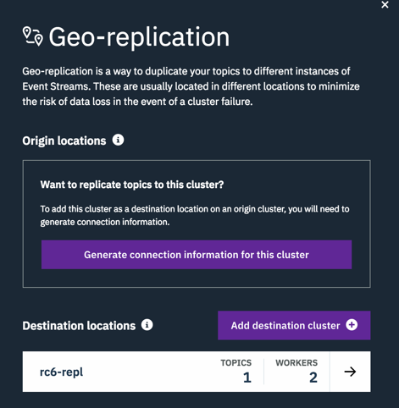
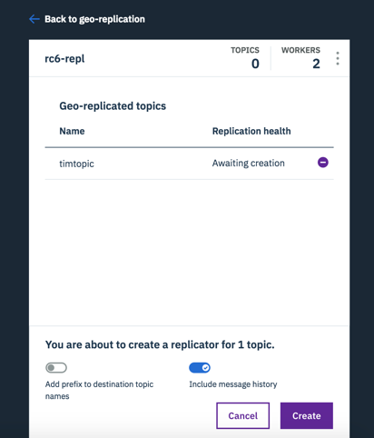
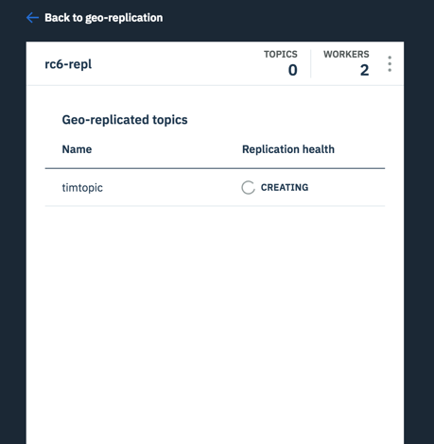
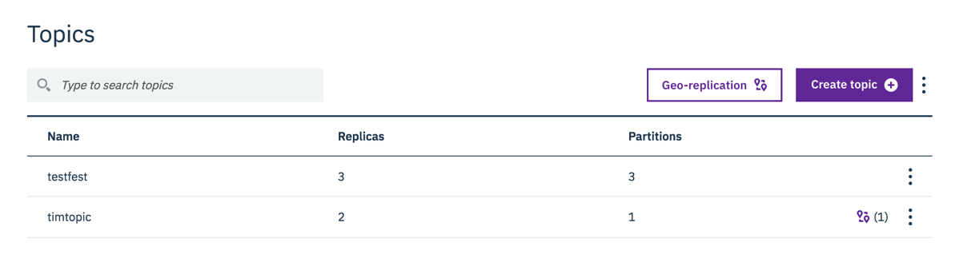
Geo-Replication is Effortless to Configure
1
2
3
Notes:
You could use geo-replication to support active / active

Slide 59
Publish Events from Anywhere with the REST Producer API
IBM has created a new easy-to-use REST Producer API
POST /topics/{topic_name}/records
Content-Type: text/plain
Authorization: Bearer {bearer_token}
Hello Event Streams
Use it wherever it’s difficult to use a real Kafka client e.g. DataPower, z/OS
Straightforward design makes it easy to use from the command line and developer tools
Supports partitioning keys and headers
So easy you can use it from the command line with cURL

Slide 60

IBM Event Streams v2019.2.1
IBM Event Streams v2019.2.1
Simple to deploy & configure
Connector Catalogue
Kafka Connect
Framework
HA and DR-ready
Powerful ops tooling
Unrivalled MQ connectivity
Support you can trust
Private Cloud
Public Cloud
Schema Registry
Container–native Software
Red Hat OpenShift
IBM Cloud Private
Isolated
aaS
Multi-tenant
aaS
Schema Registry
Kafka Connect Framework
Connector catalogue
Refreshed deal sizing info & performance benchmarks
X86_64
X86_64 & zLinux

Slide 61
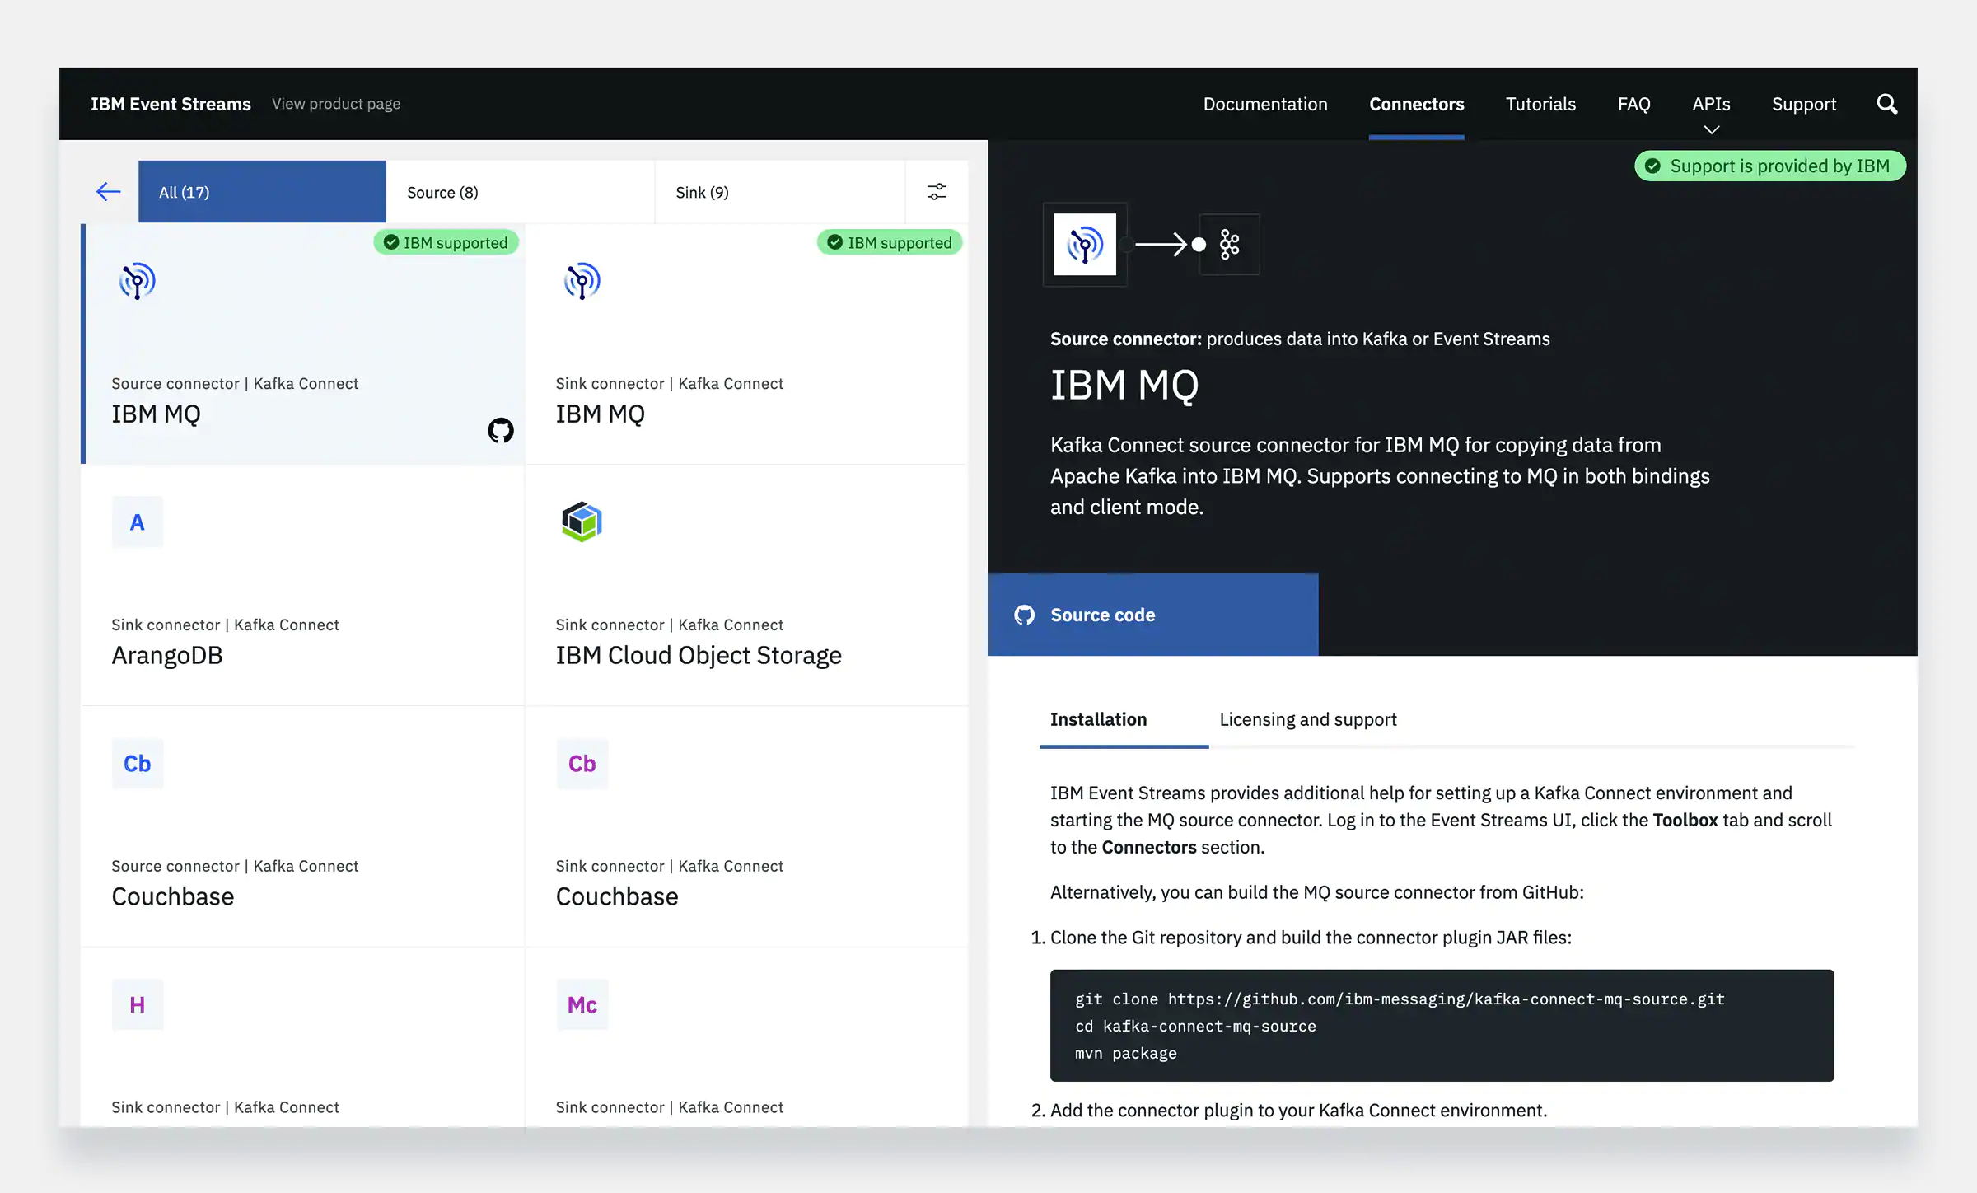
Broader Connectivity
IBM offers the easiest, most scalable way to unlock events from almost any system, especially those where installing a native Kafka client is difficult or impossible
IBM Event Streams is a core part of the IBM Cloud Pak for Integration and has excellent integration with the broader IBM portfolio, including:
MQ and unique integration with MQ for z/OS
App Connect Enterprise (via its Kafka nodes)
DataPower (via our HTTP interface)
Change Data Capture (via its Kafka Connect connector and InfoSphere Data Replication)
IoT Message Gateway (via its Kafka connector)
Most mainframe systems including CICS, IMS, DB2 (using zConnect to our REST API)
IBM Streams (via its Kafka connector)
Additionally, Event Streams for IBM Cloud has first class integrations to IoT Platform, Object Storage, Cloud Functions…
IBM Event Streams also includes a connector catalog that lists all connectors that have been tested/verified with IBM Event Streams
Notes:
This includes many connectors that were written by the Apache Kafka community. IBM does not own/ship these pieces of code, but if a customer runs in to issues with one of the verified connectors, IBM would help them diagnose the problem and facilitate getting a fix from the connector creator/owner if one is needed

Slide 62
Kafka Connectors
Connectors allow for integration from sources to sinks and vice versa
Import from sources like DBs, JDBC, Blockchain, Salesforce, Twitter, etc
Export to AWS S3, Elastic Search, JDBC, DB, Twitter, Splunk, etc
Run a connect cluster to pull from source and publish it to Kafka
Can be used with Streams
Confluent Hub has many connectors already available
Connectors can be managed with REST calls

Slide 63
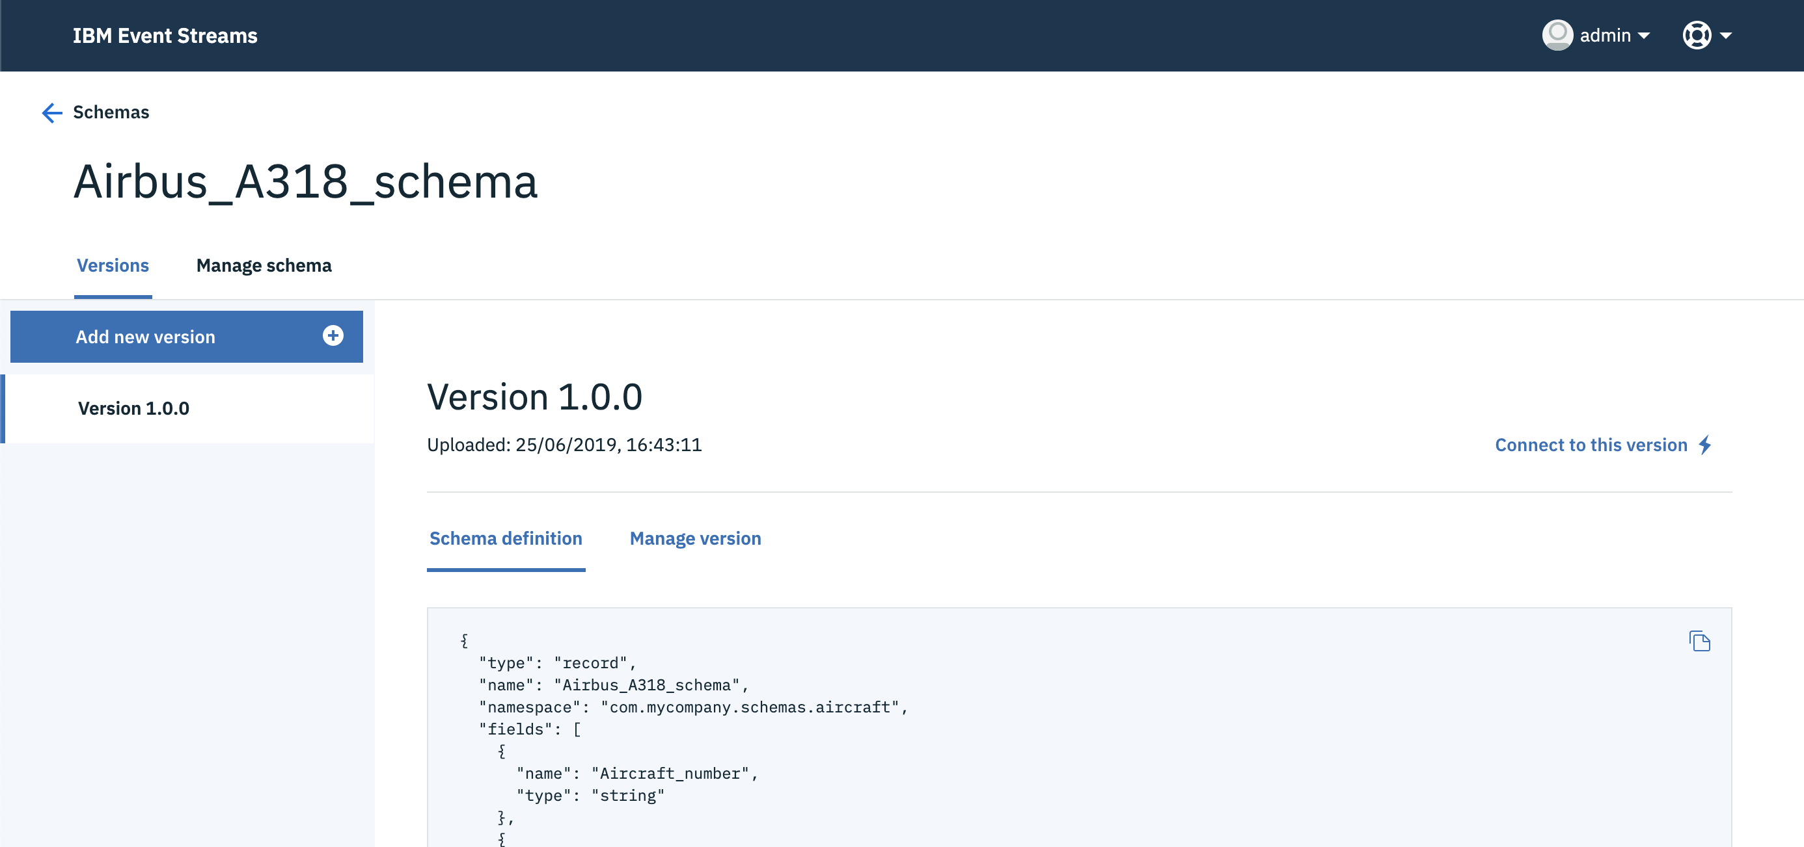
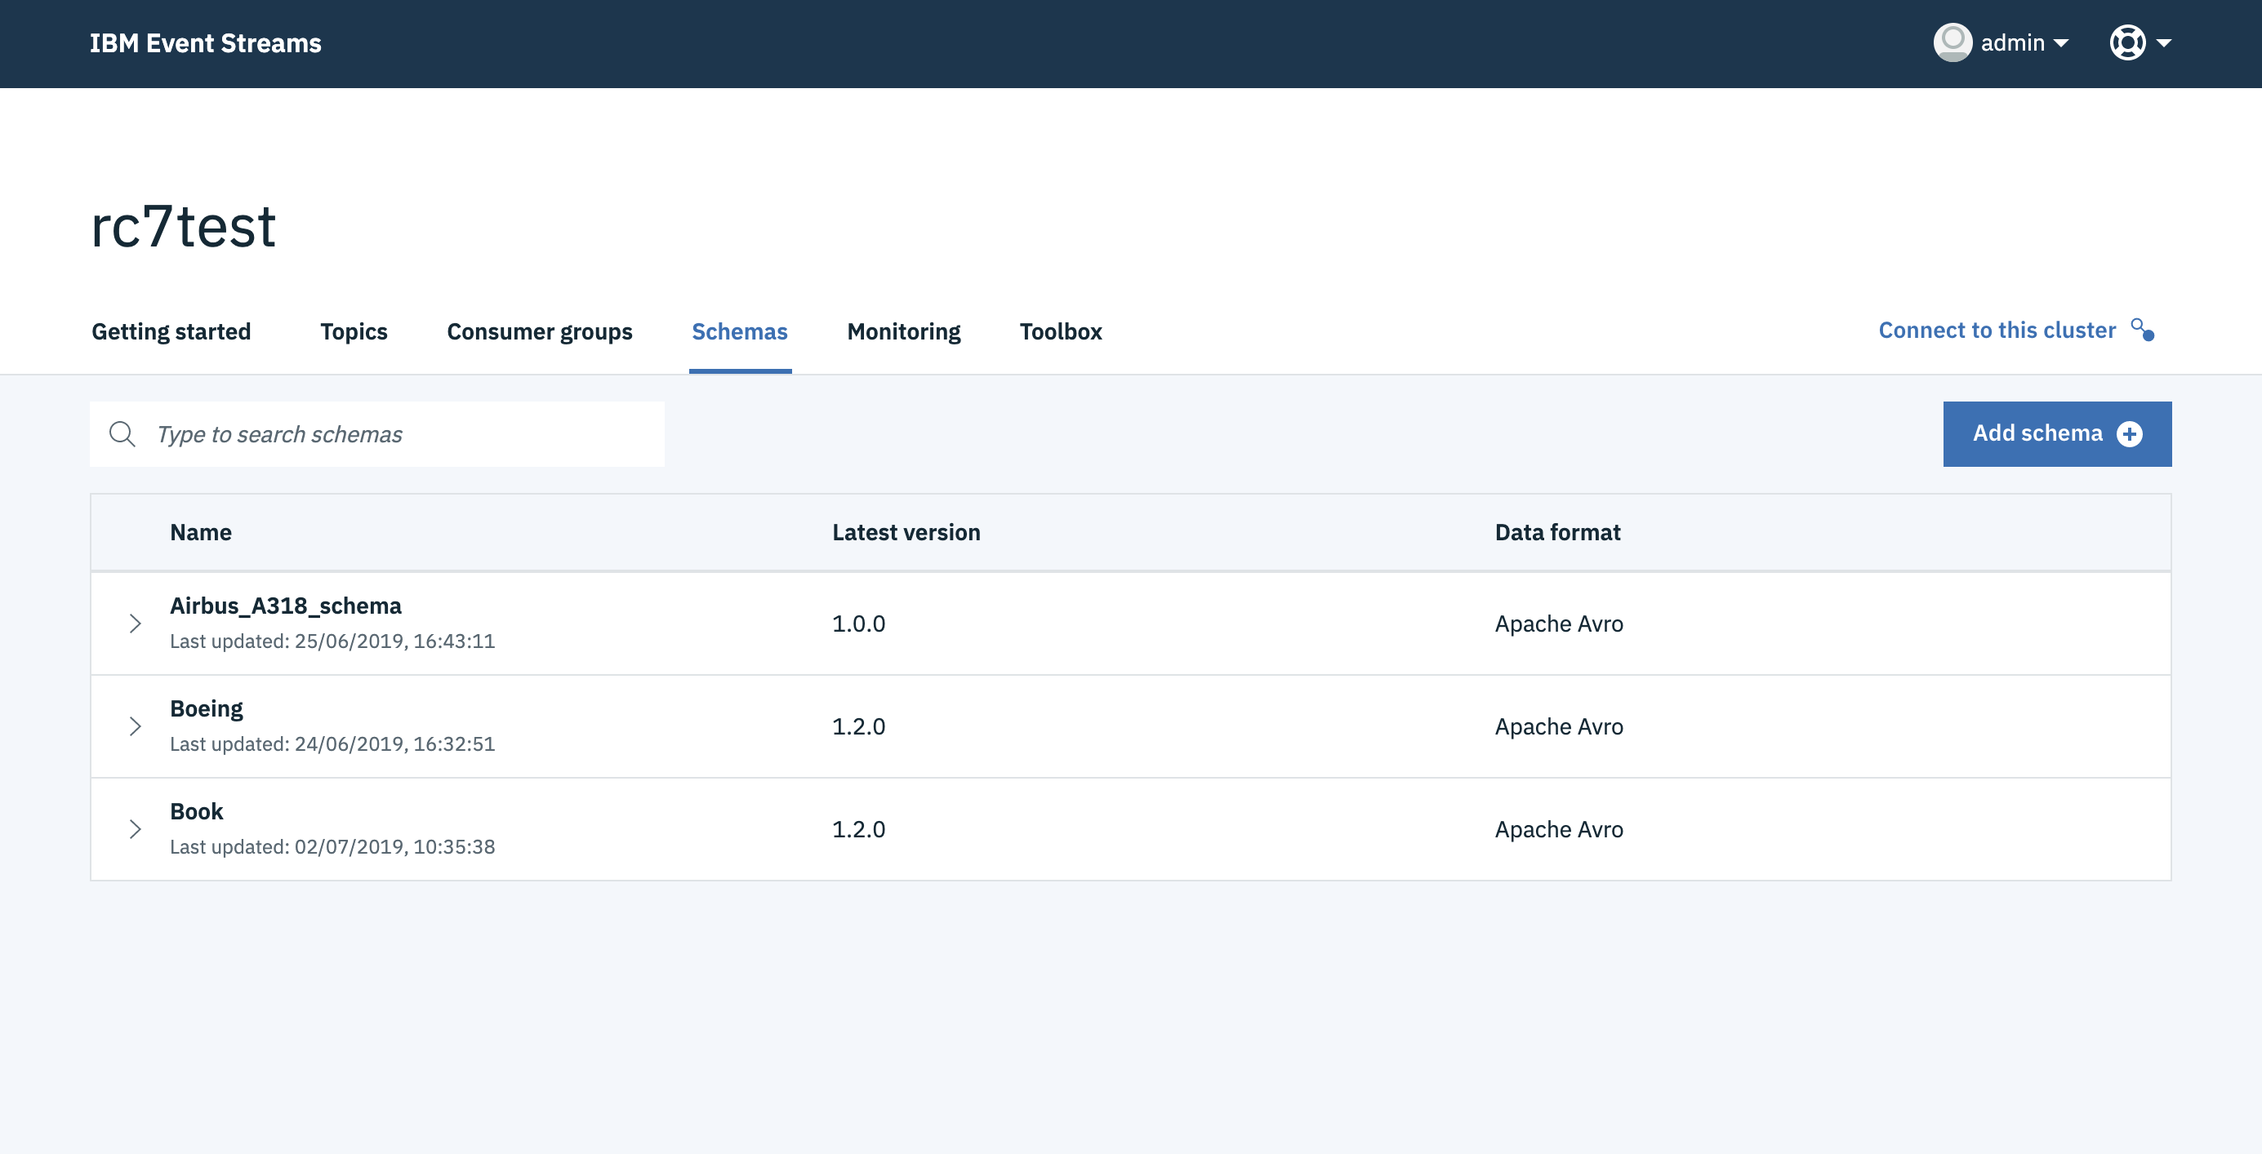
IBM Event Streams | Schema Registry
Avro Schema
{
"type": "record",
"name": "Aircraft_schema",
"namespace": "com.mycompany.schemas.aircraft",
"fields": [
{
"name": "Aircraft_number",
"type": "string"
},
{
"name": "GPS_coordinates",
"type": "string"
},
{
"name": "Departure_time",
"type": "string"
},
2. Validate & Serialize
6. Deserialize
App
3. Send
4. Receive
App
1. Request Schema
5. Request Schema
Schema Registry

Slide 64
Schema Registry
IBM Event Streams Schema Registry has been built for flexibility and extensibility. The Apache Avro supported format is only the first implementation, enabling our customers to standardize across their enterprise on their selection from a range of schema formats, and rely on IBM Event Streams to transmit, validate and interact with event records maintaining that format
IBM Event Streams schemas are defined as first-class objects with independent security controls, enabling fully secure isolation across application domains
IBM Event Streams message browsing is fully schema-aware, such that debugging application interactions is simplified, regardless of the choice of event record formatting
IBM Event Streams Schema Registry provides management of a full lifecycle for schemas and versions to support effective application lifecycle management

Slide 65
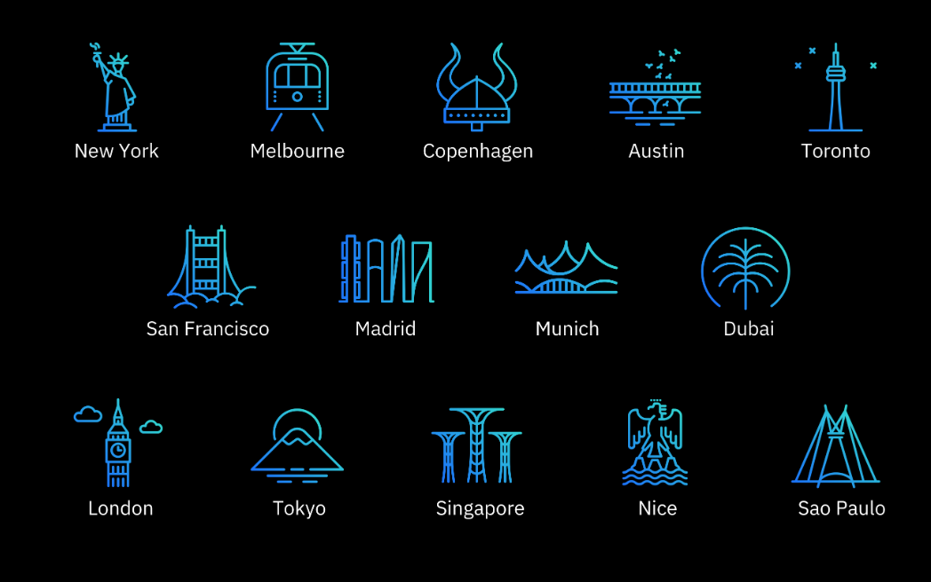
IBM Garage Locations

